Slide 1
Open-Channel SSD + FEMU
BAI Shuhan

Slide 2
1
FEMU

Slide 3
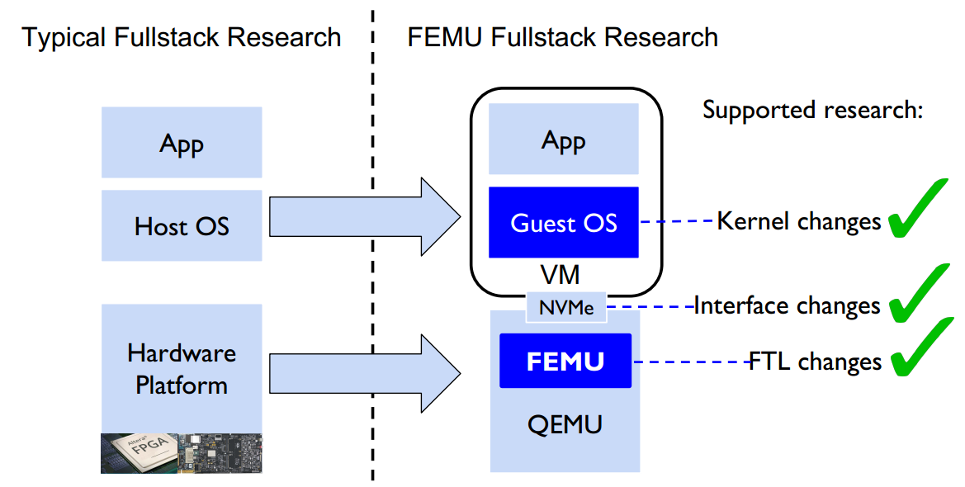
FEMU
The cost of custom OCSSD is high → software emulator FEMU
the CASE of FEMU (ChicagoU &CNEXLabs, FAST’18)
Advantages : 1) zero cost (open source code)
2) high accuracy
3) Scalability (support 32channels)

Slide 4
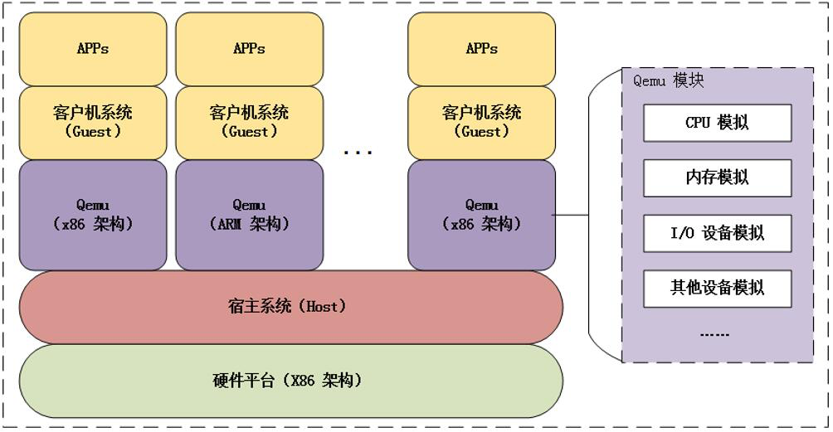
FEMU
FEMU is based on the QEMU. It partially extends the QEMU's module that simulates nvme to support higher-level simulation functions for LightNVM. Compared with the native QEMU-nvme, FEMU's expansion is mainly focused on delay simulation.
QEMU is an application program running on the host. In this application program, a hardware platform is virtualized, such as x86 architecture or arm architecture. We can run the client system on its top.

Slide 5
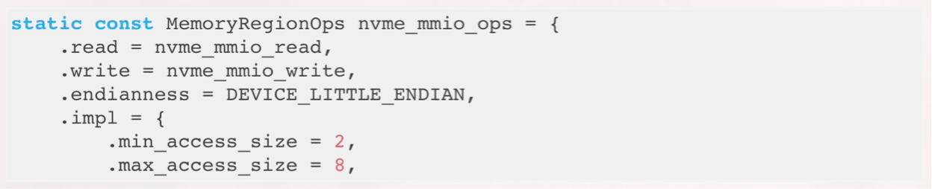
FEMU
The Nvme module needs to implement the following functions (read and write):
These two functions are the entry of the block device module for Qemu, and the entry of the nvme module that extends femu-oc in Femu. Among them, read is responsible for reading the value of the register, and write is responsible for carrying out specific processing details and writing the value of the register.

Slide 6
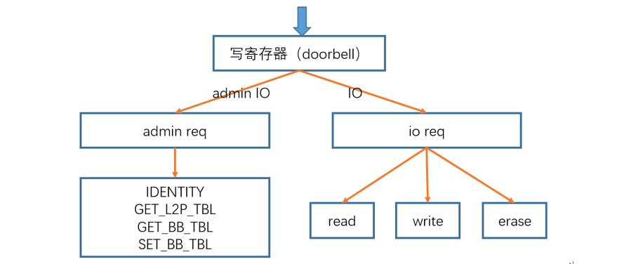
FEMU
The write function nvme_mmio_write() contains two types of command operations——Admin IO and general IO.
The operations of Admin IO correspond to the operations of LightNVM's layers, namely obtaining device geometry information, obtaining mapping table, obtaining bad block table, and updating bad block table.
General IO operations includ read, write, and erase operations.

Slide 7
Building FEMU
The startup command has been saved in the form of a script (run-blackbox.sh/run-whitebox.sh).
The environment required for Femu installation and the operation steps:
1.Python 3.8.2 2.Ubuntu 20.04.1 3.Linux 5.4.0
The additional packages and software that need to be installed have been assembled into the femu/femu-scripts/pkgdep.sh script and can be executed directly.

Slide 8
Building FEMU
1.git copy FEMU source code git clone https://github.com/ucare-uchicago/femu.git
2.enter femu/build-femu，if no such folder, need to create it under the same level directory cd femu mkdir build-femu cd build-femu
3.Copy all the files under the femu/femu-scripts folder to the build-femu folder.
In fact, we don’t need to copy all of them. The files that need to be copied are specified in the femu/femu-scripts/femu-copy-scripts.sh file, so actually only need to copy the femu-copy-scripts.sh script to build-femu folder, and then execute it. cp ../femu-scripts/femu-copy-scripts.sh . ./femu-copy-scripts.sh .
Another quick way is to copy directly cp ../femu-scripts/*.sh ../build-femu cp ../femu-scripts/ftk/* ../build-femu cp ../femu-scripts/vssd1.conf ../build-femu

Slide 9
Building FEMU
4.Execute pkgdep.sh. Because the need to install additional software packages and have assembled this script. sudo ./pkgdep.sh
5.Run femu-compile.sh ./femu-compile.sh
After successful compilation, the FEMU binary file will appear in x86_64-softmmu/qemu-system-x86_64.
6.Create a virtual machine image, which is used to simulate the hard disk of the virtual machine. We need to create a virtual image file before starting the virtual machine. Save the image as $HOME/images/u14s.qcow2 qemu-img create –f qcow2 u14s.qcow2 20G
The -f option is used to specify the image format. The qcow2 format is the most commonly used image format for QEMU. u14s.qcow2 is the name of the image file, and 20G is the size of the image file.

Slide 10
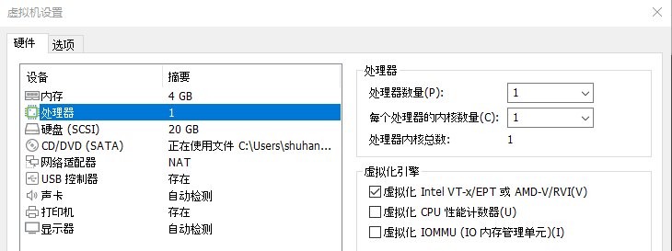
Building FEMU
7. After the image file is created, start the virtual machine and install the system. First, we need to enable the CPU virtualization function (checked in the shutdown state):
qemu-system-x86_64 –m 2G –enable-kvm u14s.qcow2 –cdrom ubuntu18.04-beta2-desktop-amd64.iso
The -m option specifies the memory size of the virtual machine; -enable-kvm uses KVM acceleration;
-cdrom adds the installation system image of u14s.qcow2. You can operate the virtual machine to install the operating system in the pop-up window. After the installation is complete, restart the virtual machine and it will start from the hard disk (u14s.qcow2).

Slide 11
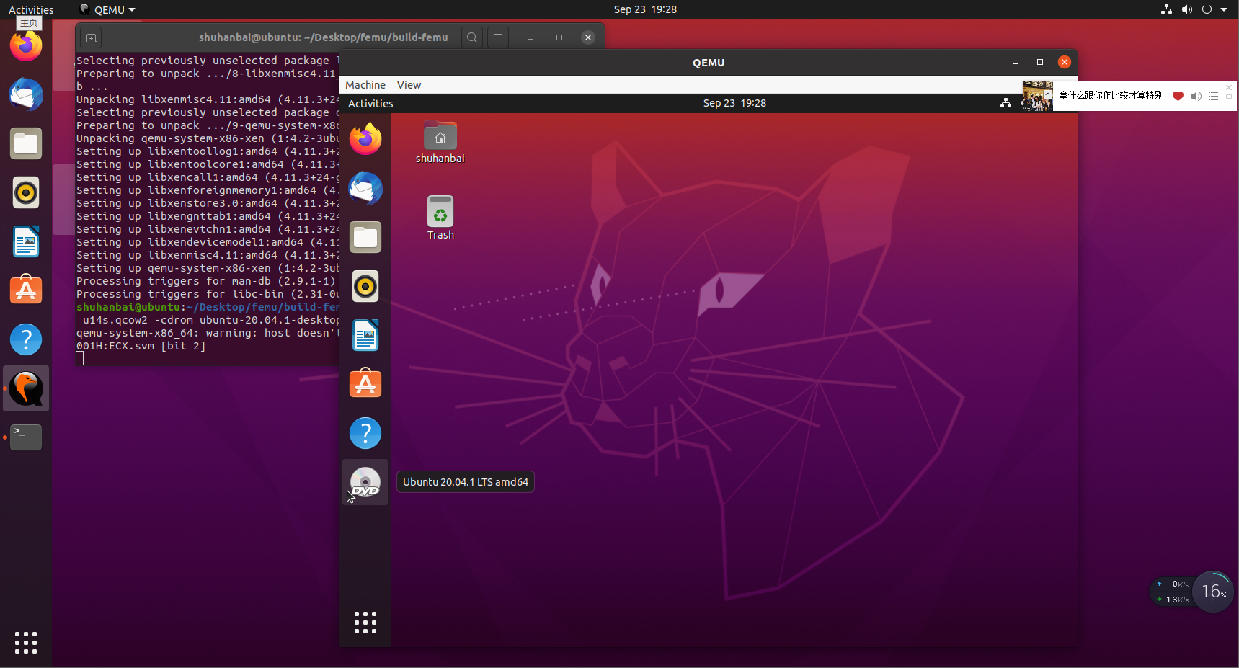
Building FEMU
Start QEMU：
qemu-system-x86_64 -m 2G u14s.qcow2

Slide 12
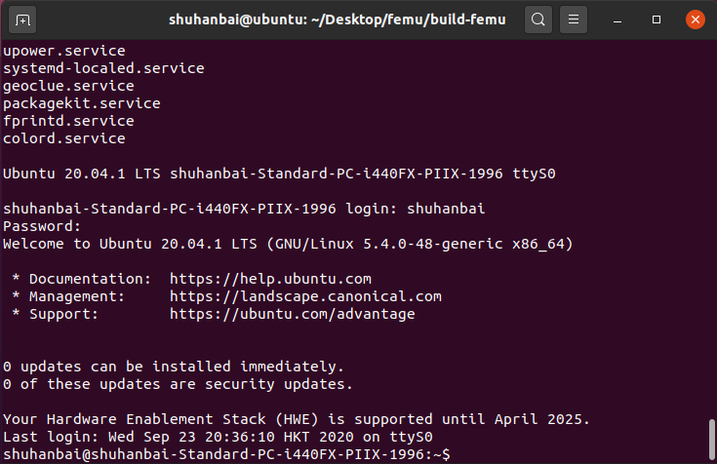
Building FEMU
8. Start FEMU:
Traditional SSDs: ./run-blackbox.sh
OCSSDs: ./run-whitebox.sh
FEMU will be started automatically after running:
For OCSSD, inside the VM, can play with LightNVM.

Slide 13
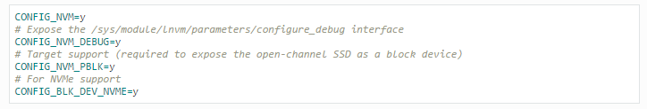
Building FEMU-OCSSD
In OCSSDs: ./run-whitebox.sh
1. Compile kernel which supports LightNVM (pblk-tool):
git clone https://github.com/OpenChannelSSD/linux.git
cd linux
git checkout for-next
make menuconfig
set :
sudo make -j4
sudo make modules_install
sudo make install

Slide 14
Building FEMU-OCSSD
In OCSSDs: ./run-whitebox.sh
2. Install userspace library liblightnvm:
git clone https://github.com/OpenChannelSSD/liblightnvm.git
cd liblightnvm
make configure
make
sudo make install
3. Install userspace tool nvm-cli:
sudo apt install nvme-cli

Slide 15
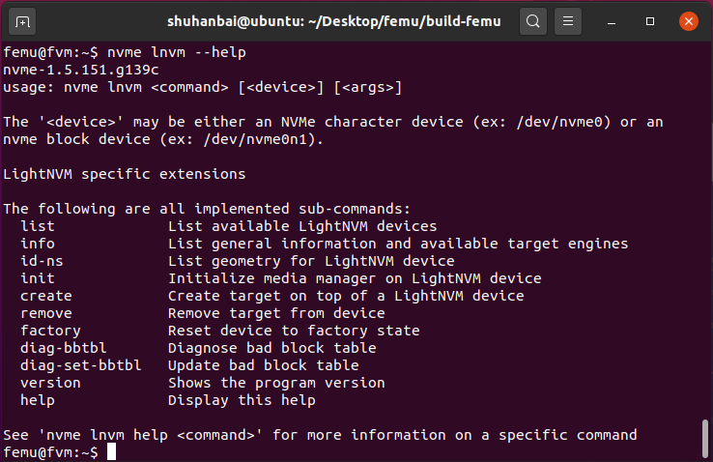
Testing Command-Line Interface (CLI)
In OCSSDs: ./run-whitebox.sh
1. LightNVM can be interfaced through the nvme cli tool(nvme-cli). It allows us to create, delete, and manage LightNVM targets and devices. After nvme-cli has been installed, its commands can be listed with:
nvme lnvm --help

Slide 16
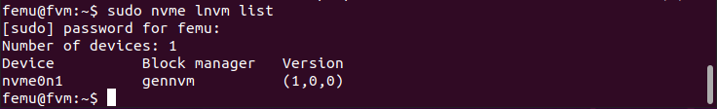

Testing Command-Line Interface (CLI)
In OCSSDs: ./run-whitebox.sh
2. To list devices and target types registered with LightNVM.
1) To list registered devices:
sudo nvme lnvm list
a registered device named nvme0n1, whose path is /dev/nvme0n1
2) To list available target type(s) and their version:
sudo nvme lnvm info
the device supports targets whose type is pblk

Slide 17
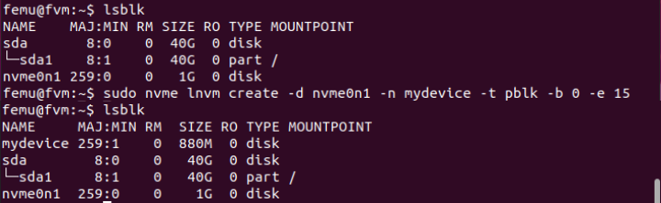
Testing Command-Line Interface (CLI)
In OCSSDs: ./run-whitebox.sh
3. A device must first have a media registered when it is first uesd, i.e., initialize LightNVM device with media manager：
nvme lnvm init -d nvme0n1
4. To add a target on top of a device registered with the gennvm media manager:
for example, to allocate LUNs 0 to 15 to a pblk instance named mydevice using the NVMe device nvme0n1:
nvme lnvm create -d nvme0n1 -n mydevice -t pblk -b 0 -e 15
A target instance can be removed again by:
nvme lnvm remove -n $TARGET_NAME

Slide 18
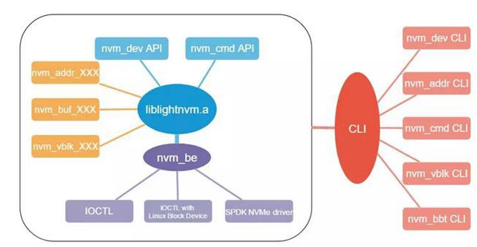
Testing Command-Line Interface (CLI) - liblightnvm
In OCSSDs: ./run-whitebox.sh
libIightnvm provides a method for the interaction between Open-Channel SSD and the user space, it also provides a method for users to obtain devices' information. Its components are as follow：
Retrieve device information
Construct and convert addresses
Execute admin commands
and IO commands
Erase, write, read virtual blocks
Retrieve (get) and modify
(set/mark) the bad block table

Slide 19
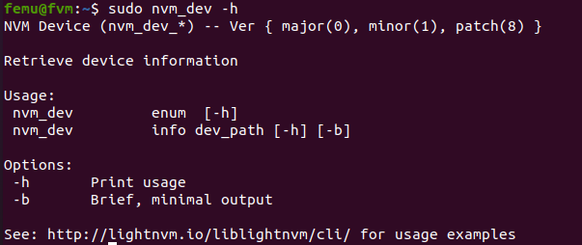
Testing Command-Line Interface (CLI) - nvm_dev
In OCSSDs: ./run-whitebox.sh
nvm_dev
Retrieve device information

Slide 20
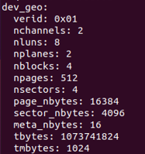
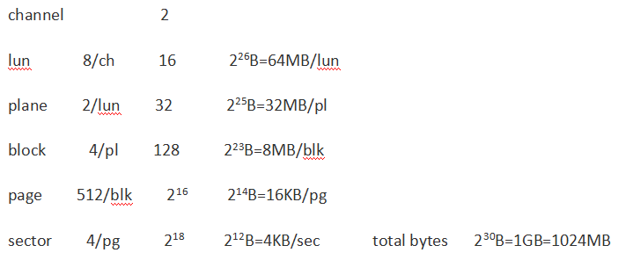
Testing Command-Line Interface (CLI) - nvm_dev
In OCSSDs: ./run-whitebox.sh
5. Retrieve device information from the OCSSD at the path /dev/nvme0n1：
sudo nvm_dev info /dev/nvme0n1
we can get device geometry:

Slide 21
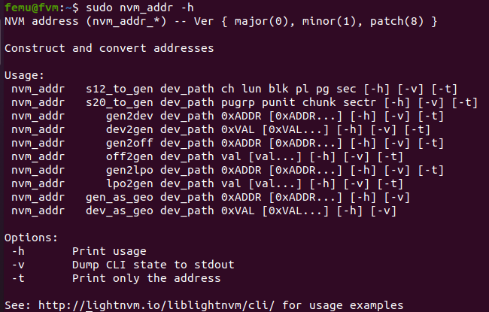
Testing Command-Line Interface (CLI) - nvm_addr
In OCSSDs: ./run-whitebox.sh
nvm_addr
Construct and convert addresses

Slide 22
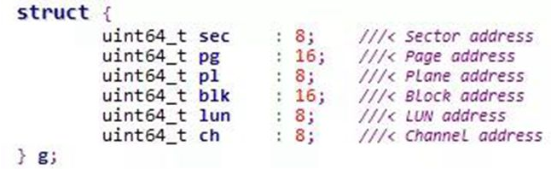
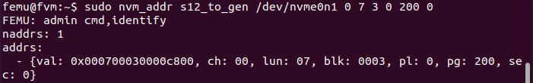

Testing Command-Line Interface (CLI) - nvm-addr
In OCSSDs: ./run-whitebox.sh
6. Physical Addressing: Most of the library takes one or more physical addresses as parameter.
1) Generic format: The physical addresses are represented in generic format by the data-structure struct nvm_addr. We can construct an address by specifying the relative location within the device geometry down to the granularity of a sector:
sudo nvm_addr s12_to_gen dev_path ch lun blk pl pg sec
for example, construct an address for sector 0 within page 200 in block 3 on plane 0 of LUN 7 in channel 0:
sudo nvm_addr s12_to_gen /dev/nvme0n1 0 7 3 0 200 0
※noted:
Order: channel→lun→block→plane→page→sector
Number of hexadecimal digits: 2/2/4/2/4/2

Slide 23

Testing Command-Line Interface (CLI) - nvm_addr
In OCSSDs: ./run-whitebox.sh
6. Physical Addressing: Most of the library takes one or more physical addresses as parameter.
2) Device format: Corresponds to PPA.
sudo nvm_addr gen2dev /dev/nvme0n1 0x000700030000c800
3) Geometry format:
sudo nvm_addr dev_as_geo /dev/nvme0n1 0x000000000001f640

Slide 24
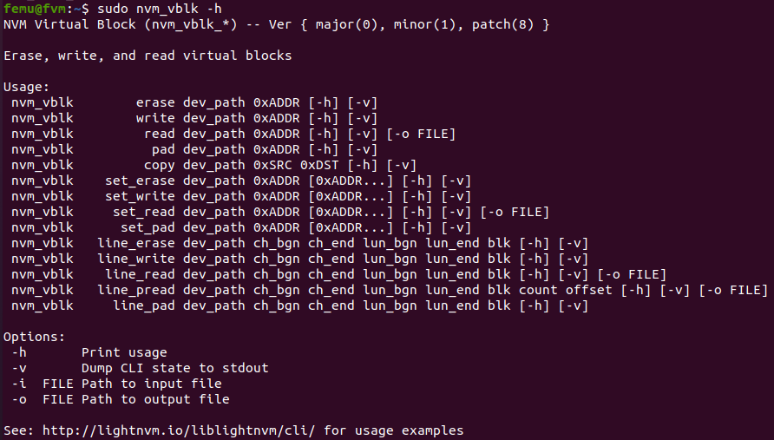
Testing Command-Line Interface (CLI) - nvm_vblk
In OCSSDs: ./run-whitebox.sh
nvm_vblk
Erase, write, and read virtual blocks
plane span
block set
block line

Slide 25
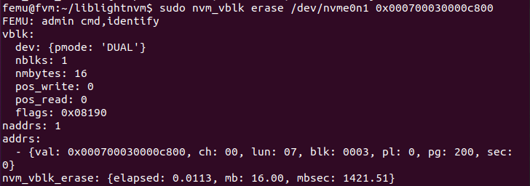
Testing Command-Line Interface (CLI) - nvm_vblk
In OCSSDs: ./run-whitebox.sh
7. Vectorized IO to NAND media (Plane Span)
1) Erase before write:
sudo nvm_vblk erase /dev/nvme0n1 0x000700030000c800
If an erase fails as above then it is because a block is bad. The bad-block-table interface (nvm_bbt) is provided to communicate and update media state.

Slide 26
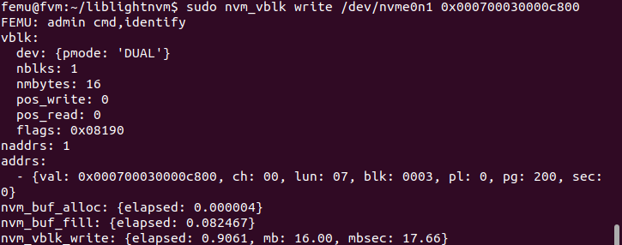
Testing Command-Line Interface (CLI) - nvm_vblk
In OCSSDs: ./run-whitebox.sh
7. Vectorized IO to NAND media
2) Write:
sudo nvm_vblk write /dev/nvme0n1 0x000700030000c800

Slide 27
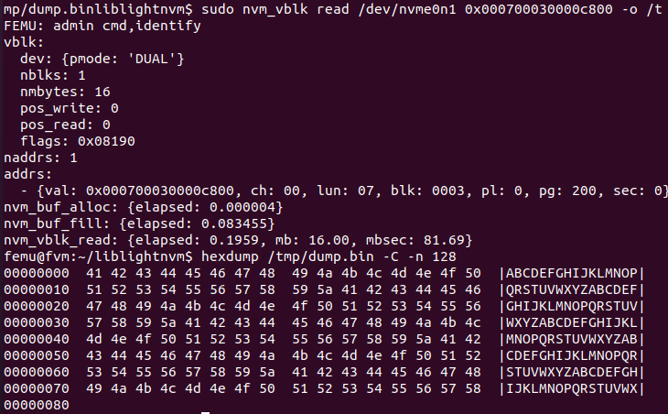
Testing Command-Line Interface (CLI) - nvm_vblk
In OCSSDs: ./run-whitebox.sh
7. Vectorized IO to NAND media
3) Read:
the data read from device can be written to a file system using the -o FILE option,and the payload is then available by inspection, e.g. with hexdump
sudo nvm_vblk read /dev/nvme0n1 0x000700030000c800 -o /tmp/dump.bin
hexdump /tmp/dump.bin -C -n 128

Slide 28
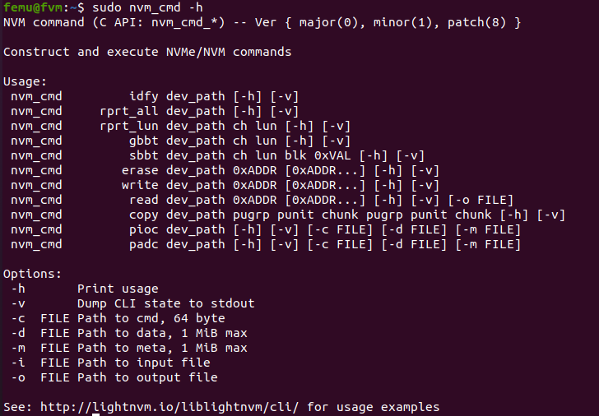
Testing Command-Line Interface (CLI) - nvm_cmd
In OCSSDs: ./run-whitebox.sh
nvm_cmd
Construct and execute NVMe/NVM commands

Slide 29
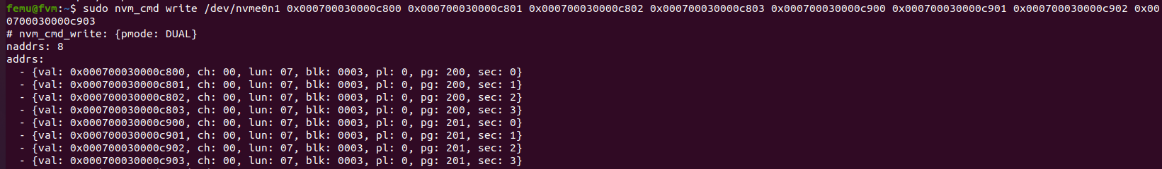
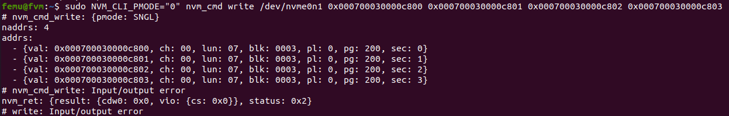
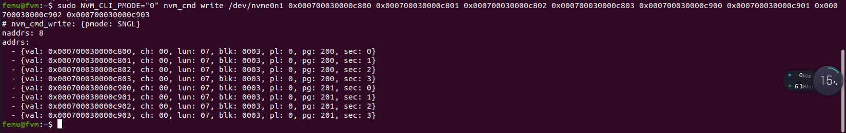
Testing Command-Line Interface (CLI) - nvm_cmd
In OCSSDs: ./run-whitebox.sh
Some problems!!!
sth. about ws_min?
ws_min is a parameter that indicates the minimum number of sectors written at one time.
It is a parameter of OCSSD 2.0, but FEMU only supports OCSSD 1.2.

Slide 30
Testing Command-Line Interface (CLI) - I/O
In OCSSDs: ./run-whitebox.sh
Some problems!!!

Slide 31
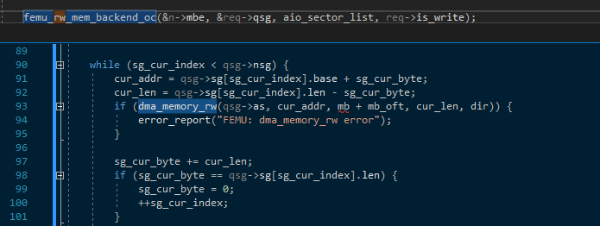
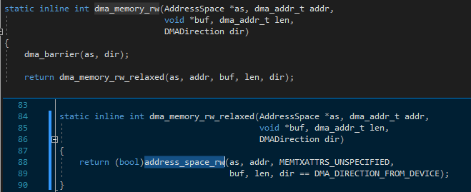
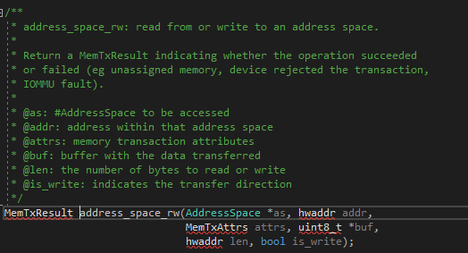
(ISC) Adding an easy computation thread to test
Finding the place to intercept data:

